Slide 1



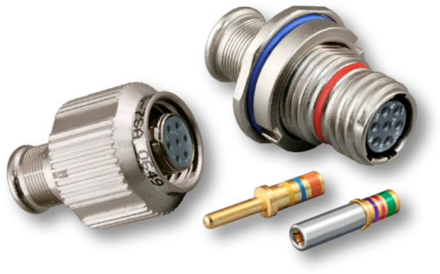


Slide 2
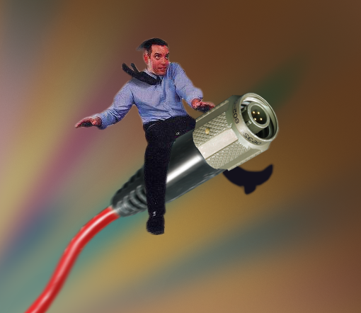

Glenair
An Interconnect Industry Leader Since 1956
Privately owned—same location, no off-shore manufacturing
600,000 square feet of factory space in Glendale alone! Additional factories in Italy and the UK
Primary Market: military and aerospace interconnect systems
Excellent customer service and technical product know-how
Huge inventory of finished goods

Slide 3
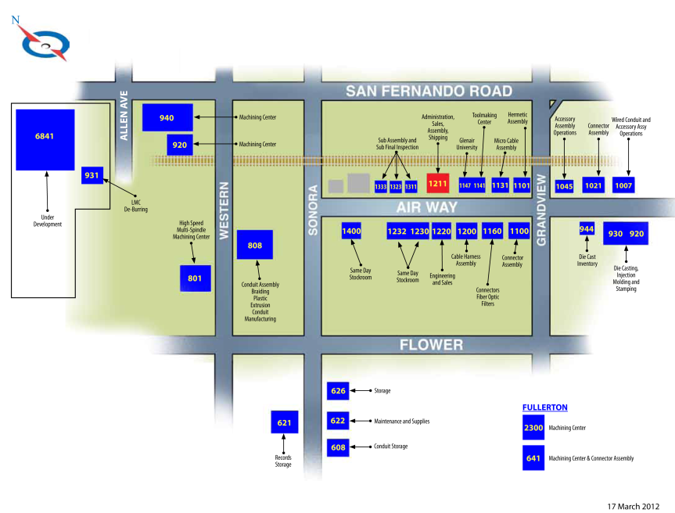
Southern California Campus

Slide 4


Slide 5


Contacts and Wire

Slide 6
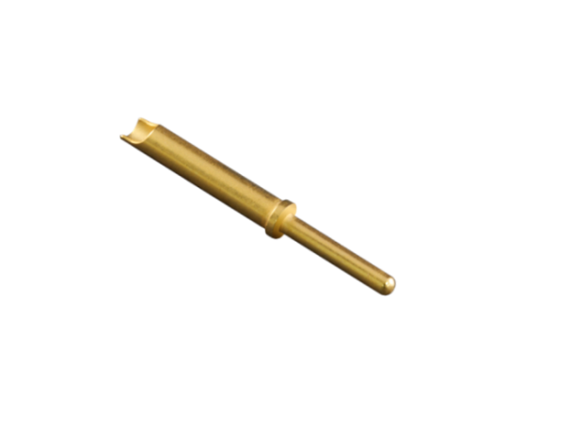
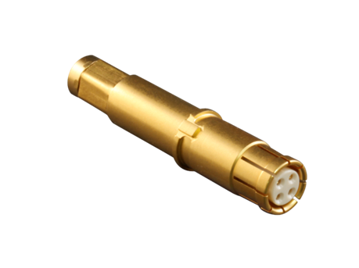
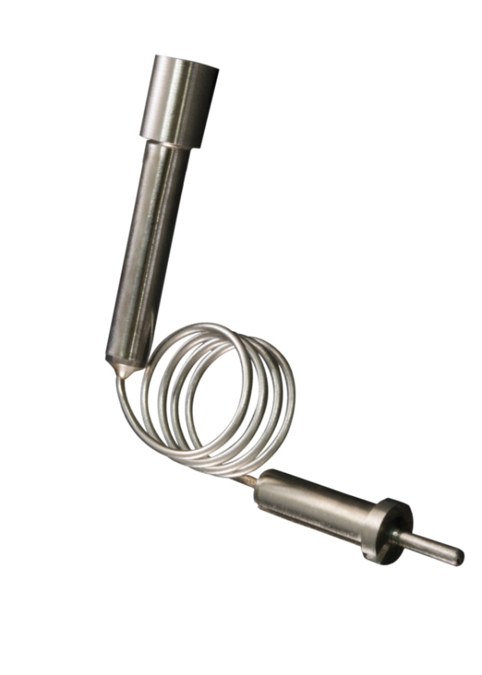
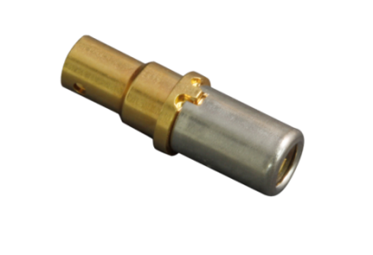
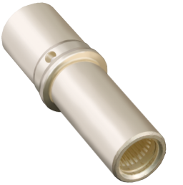
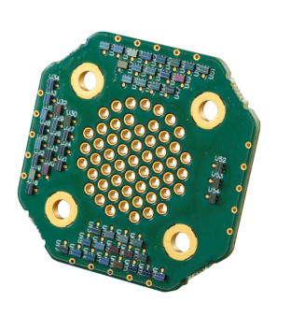
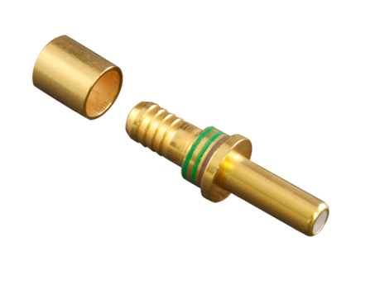
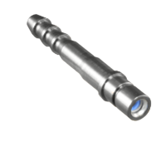
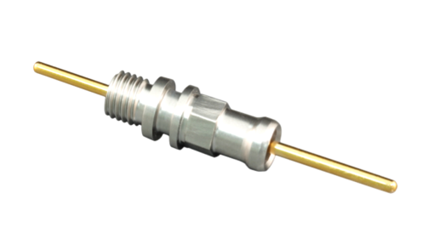
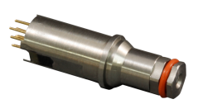
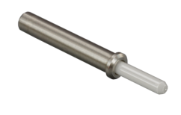

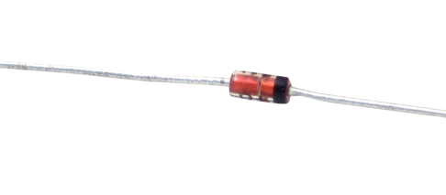
We Never Lose Contact
From electrons to photons to fluids
Signal &
Thermocouple
EMI/EMP
Filter
Coax
#8 Optoelectronic
Pneumatic
Fluids
Nano & Micro
TwistPin
Power &
LouverBand
Hermetic
#8 Quadrax
Fiber Optic

Slide 7
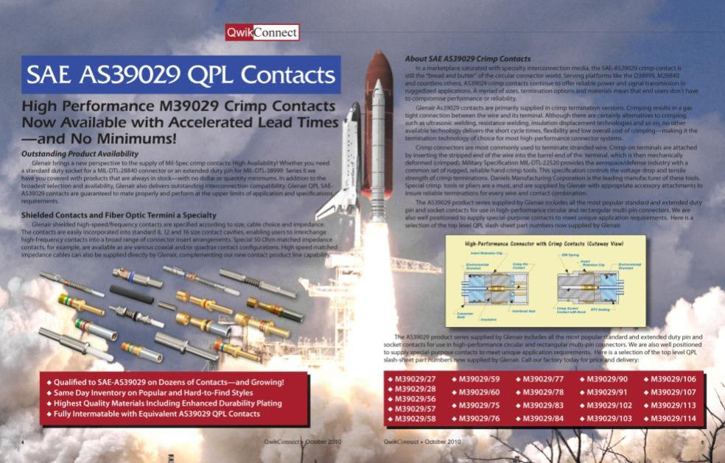

AS39029 Contacts: Signal/Shielded/Specials
Notes:
7

Slide 8
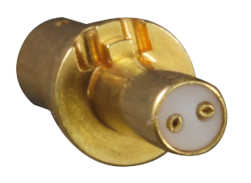
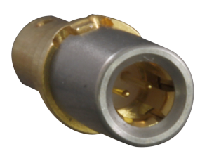
NextGen High-Speed TwinAx
Glenair designed contact for eSATA, LVDS, CML etc.
For use in #12 Mighty Mouse and Micro-Crimp cavities
Special TwinAx Thermax Celltec wire

Slide 9


Ultraminiature Circulars

Slide 10

Series 80 Mighty Mouse Connectors
The New Industry Standard for Reduced Size
and Weight Applications
Half the size and weight of D38999—with all the performance!
Currently specified on hundreds of mission-critical applications

Slide 11
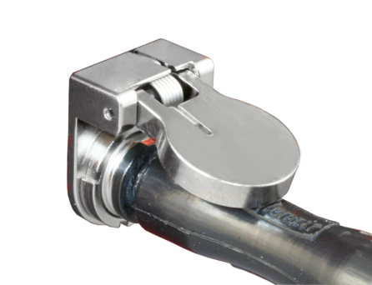
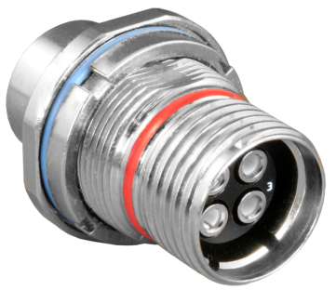
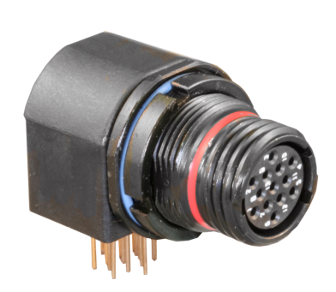
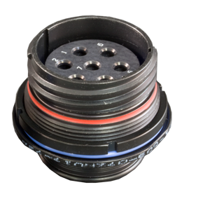
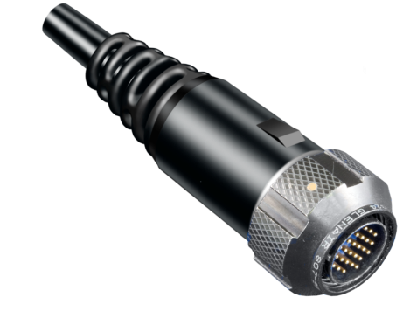
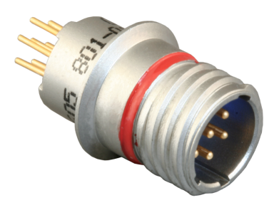
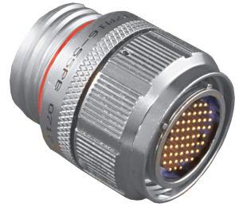
“Mighty Mouse” is a Complete Solution

Slide 12
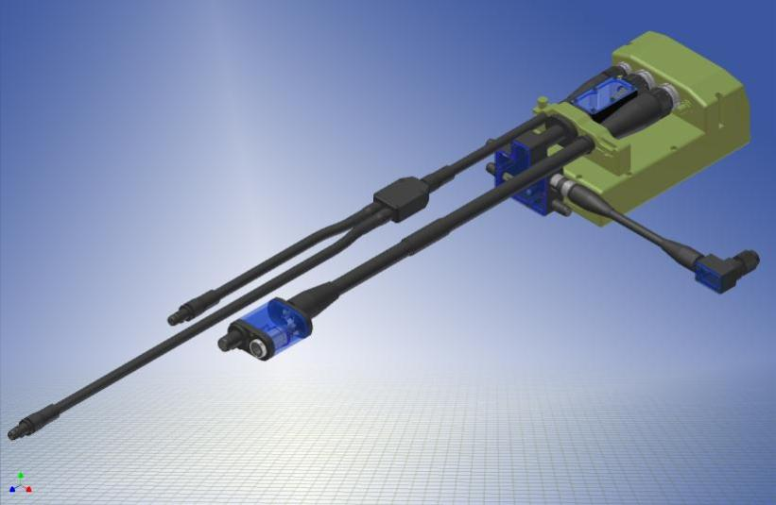
Mighty Mouse Cables and Integrated Systems are our Specialty

Slide 13
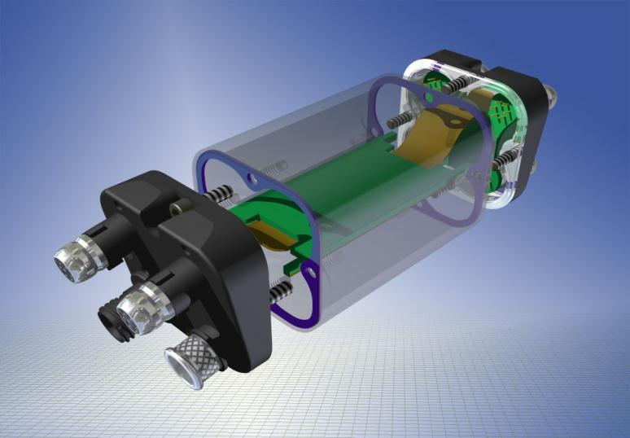
Innovative Mighty Mouse “Cans:” Versatility and Consolidation

Slide 14

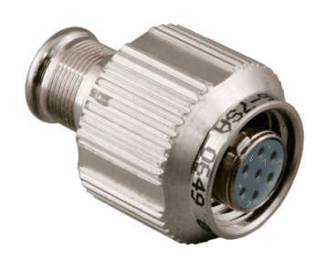

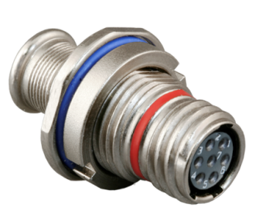
New Series 80 Mighty Mouse High-Speed with Teflon® Inserts for SATA, USB 3.0

Slide 15

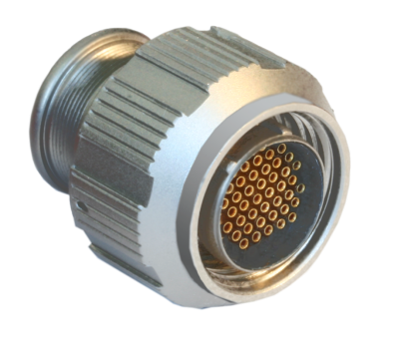
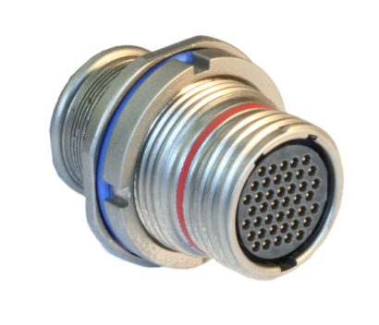
Series 811 Mighty Mouse HD
Micro TwistPin Mighty Mouse
Double the pincount of standard MM

Slide 16
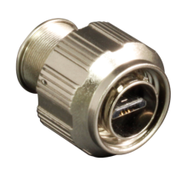
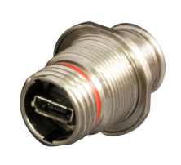
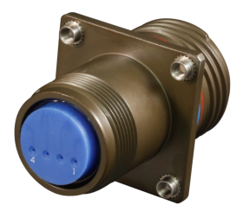
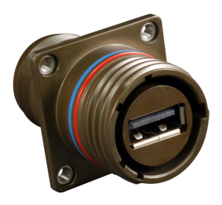
SuperSeal™ Mighty Mouse and D38999 RJ-45 and USB
IP68 sealing in unmated condition
Crimp and poke termination
Superior grounding

Slide 17

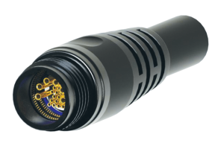
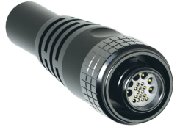
Series 88 SuperFly™
Ultraminiature Cordsets
Innovative new hybrid connector/cordsets
Nano, Micro and Size #23 contacts
Soldier gear and other tactical apps
Optimized for high speed

Slide 18
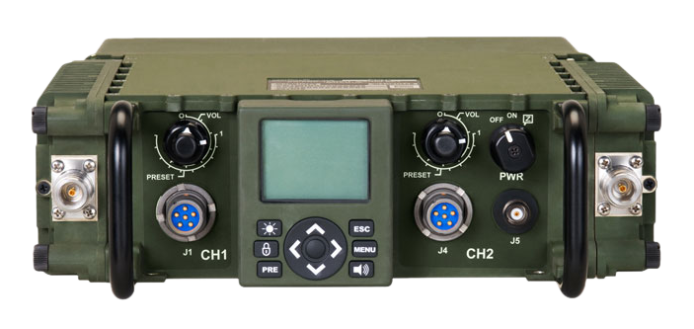
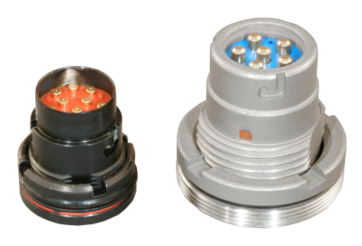
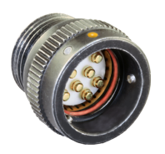
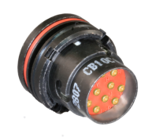
Series 15 Audio Connectors
QPL and “HiPer” versions of popular 55116 comms connector
VG qualified ultra- miniature CB Series

Slide 19
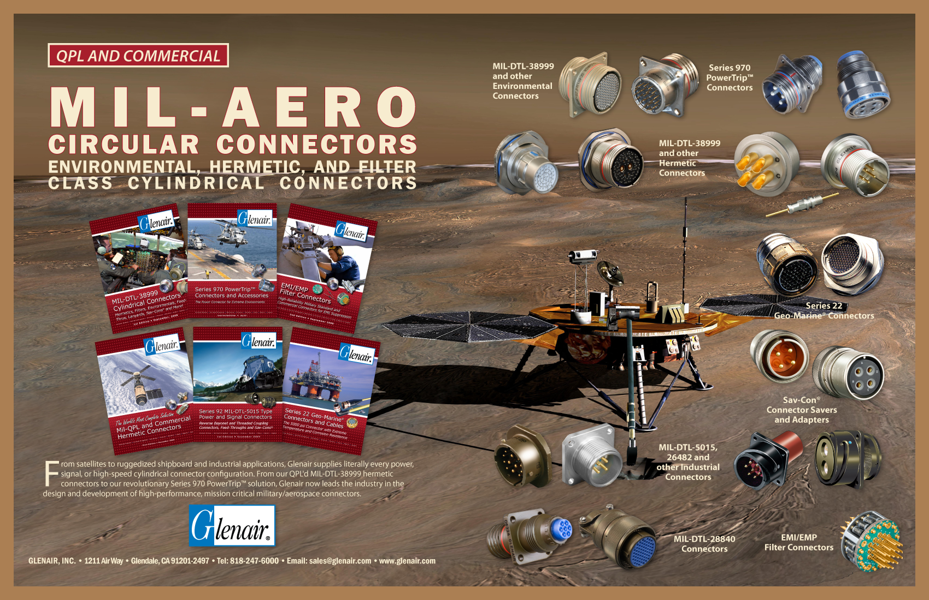

Mil-Aero Circulars

Slide 20
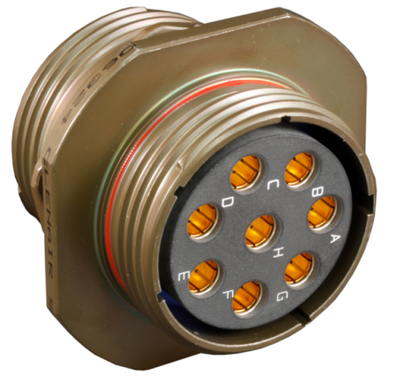
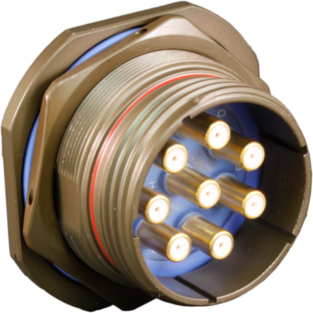
Standard Environmentals:
Example: 38999 Environmental TBF and STD Receptacles with Coax

Slide 21
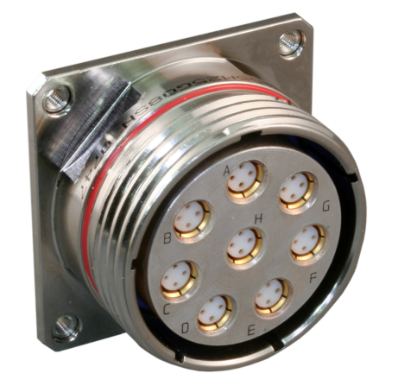
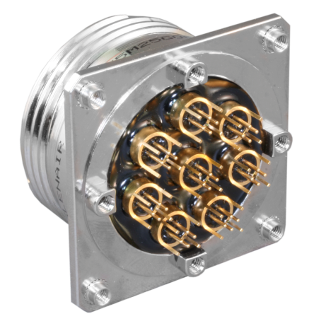
Thermoset Plastic Potted Environmental:
Example: 38999 with Quadrax PC Tails
Mod Code 491 Backfill and Potting

Slide 22
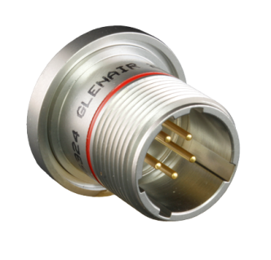
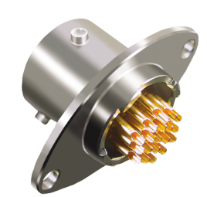
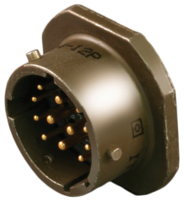
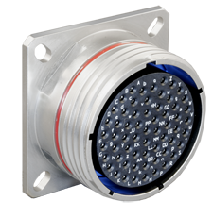

Hermetic Sealing Can Be Implemented for Any Circular Connector Package…
Technology Supports Both Pin and Socket Contact in Any Receptacle Style
MIL-DTL-
26482
MIL-DTL-
83723
MIL-DTL-
38999 (QPL)
MIL-DTL-
5015
Series 80
Mighty Mouse
These are all standard catalog product offerings at Glenair

Slide 23

We Even Do Hermetic Coax

Slide 24




Series 970 PowerTrip™
The Ultimate Marriage of “Trip 9” Packaging and High-Performance Power
MIL-DTL-5015
MIL-DTL-38999
MIL-DTL-28840
PowerTrip™

Slide 25

Series 970 PowerTrip™ Contacts
The High Performance LouverBand
High conductivity copper body
Beryllium copper spring
Higher ampacity
Size 1/0 thru size 16

Slide 26

Ruggedized Industrial Power and Signal Connectors

Slide 27
Series 22 Geo-Marine
5000 PSI piston-sealed extreme environmental submersible
Undersea exploration, pipeline inspection, and off-shore drilling
8 shell sizes / 31 insert arrangements
Withstand 5000 PSI (mated)
Major customers include: Halliburton, Schilling Robotics, British Gas and Pipetronics

Slide 28


Series 24 EMI/EMP Filter Connectors
In-House Fabrication of Multi-Pin Planar Array Connectors for EMI Suppression
Turnkey EMI/EMP solutions: from analysis to delivery, Glenair does it fast and right
Order straight from the catalog or specify a custom design

Slide 29


Glenair Delivers Filter Technology in Every Density: From Mighty Mouse to 5015

Slide 30



Mil-DTL-38999 (Series III) EMI/EMP Filters: Special Packaging

Slide 31

Sav-Cons®
Rugged Connector Go-Betweens for D38999 and Other
Mil-Spec Connector Series
Available for all standard MS circular connector lines
Protect expensive test equipment and cables from excessive wear and tear.
One-piece feed-through contact
Suitable for flight use--meets the same specifications as the mating connector

Slide 32






Summary of Circular Sizes/Densities
Ultra
miniature
Micro
miniature
Nano
miniature
Standard
Miniature
Subminiature
MIL-DTL-5015
MIL-DTL-22992
MIL-DTL-28840
MIL-DTL-26482
MIL-DTL-26500
MIL-DTL-83723
Sr. 80
Mighty Mouse
Sr. 811
Mighty Mouse
HD
Sr. 88
SuperFly
MIL-DTL-38999

Slide 33



Slide 34




The Series 89 Nano Connector Range
Super small, light weight and versatile,
High reliability TwistPin contact system for added performance and reliability.
Ideally suited for use in down-hole electronics, space systems, missile systems and avionic enclosures.

Slide 35

Micro-D Connectors and Cables
Ultra-Miniature Rectangular Connectors for
Mission-Critical Applications
.050 inch Micro layouts deliver optimal connector package density
Machined shells and TwistPin contacts deliver optimal reliability and performance

Slide 36

Series 171 MicroStrips
When the time arrives to graduate from
COTS performance to Military Performance
New and improved version
of MWS strips
Latches for secure mating
Guide Pins
Board mount
Surface mount

Slide 37




MLDM Low-Profile Micro-D
MLDM
.260” height
MWDM-51
.351” height
Pre-Wired Pigtail
Right Angle Board Mount
Solder Cup

Slide 38


Well-Master™ 260 (GHTM)
The high temperature Micro-D for +260°C applications

Slide 39

HiPer-D: Intermateable w/ Mil-C-24308
The Extreme Duty D-Sub Connector

Slide 40

HiPer-D 24308

Slide 41

Series 79 Micro-Crimp
Connectors and Cables
The Micro-D Connector with Crimp Contacts: Power, Signal and COAX
Incorporates crimp contact technology into an innovative, precision-machined, micro-density, module-to-chassis connector package
Dozens of tooled layouts

Slide 42

Micro-Crimp Advantage other Rectangulars:
Smaller, with Improved Shielding and Sealing
Higher Density than MIL-DTL-24308 and ARINC
Better Performance than MIL-PRF-83513
EMI spring on plug—aluminum shroud on right angle PCB
Shielding effectiveness: 60 dB attenuation min from 100 MHz to 1000 MHz
IP67 protection from water ingress
Guide pins for blind mating

Slide 43


Special Hermetic Rectangulars
MIL-DTL-24308 (QPL)
MIL-PRF-83513
Again…standard catalog product offerings

Slide 44


Special ARINC’s: Filters and Quadrax

Slide 45




Rectangular Series Summary
Hiper-D
Micro-Crimp
Micro-D
Nano
Glenair Sr. 28
M24308
5 - 7.5 AMPs
11 Layouts
9-104 Positions
Crimp, Pre-Wired, Solder Cup, PCB
Glenair Sr. 79
N/A
5-23 AMP
31 Layouts
2-102 Positions
Crimp, Pre-Wired, Solder Cup, PCB
Glenair Sr. 17
M83513
3 AMP
8 Layouts
9-100 Positions
Pre-Wired, Solder Cup, PCB
Glenair Sr. 89
M32139
1 AMP
7 Layouts
9-51 Positions
Pre-Wired, PCB

Slide 46



Slide 47


MIL-DTL-38999 Type
Most Popular Aerospace Fiber Optic Connection System

Slide 48



High Density (GHD)
For 50% + Size and Weight Reduction

Slide 49

Size #23 Fiber Optic Mighty Mouse
Even Smaller and Lighter
Notes:
49

Slide 50



M28876 Fiber Optic Connection System
Glenair M29504/14 and /15 Termini

Slide 51




GFOCA M83526 Compliant
Hermaphroditic

Slide 52





Eye-Beam Fiber Optics

Slide 53
Eye-Beam Grin Lens Terminus
9.0 micron fiber core.
Fiber surfaces exposed and susceptible to damage.
must be cleaned prior to mating.
9.0 micron core is expanded to approx. 270 microns.
Fiber surfaces protected and do not touch.
Easy clean of lens surface.
Notes:
53

Slide 54



Glenair Fiber Optic Media Converters
Gigabit Ethernet Fiber-Optic Media Converter
  Converts Gigabit Ethernet (1000BASE-T) from copper twisted pair to a pair of optical fibers
  Ruggedized packaging for -40C to +85C operation
  .
Digital Visual Interface (DVI) Fiber-Optic
Media Converter
  R,G,B, clock signal transport
Size-8 Active Contact
  Up to 4.25 GB/sec
  10 GB version coming
“050-100 Series”
Gigabit Ethernet
Media Converter
“050-300 Series”
Size-8 Media Converter
“050-200 Series”
DVI Media Converter

Slide 55



Slide 56











Series 77 Full Nelson
Convoluted Boots and Transitions

Slide 57

New Materials
2050 Type 5
Viton Fluoroelastomer Blend
2051 Type 6
High Performance Elastomer Alloy
2071 Type 7
Flexible Polyolefin
Page A-4

Slide 58


High-Performance Jacket Materials:
Flexible, environmentally- tough jacketing For conduit and cable

Slide 59

Innovative, Braided Wire Cable Shields and Coverings
Lightweight, Flexible Shielding Solutions for Advanced EMI
and Abrasion Protection
Dozens of material choices, from conductive metals to high-temperature plastics
Available in tubular braided form or applied directly to your assembly

Slide 60

AmberStrand® Conductive Composite Braid
The Smart Way to Reduce Launch and Flight Weights
in Aerospace Systems
Metal-clad composite material delivers outstanding EMI shielding performance
Flexible material resists kinks and bends that diminish shielding effectiveness

Slide 61

ArmorLite™ Microfilament Stainless Steel Braided Shielding
Extremely lightweight and temperature tolerant conductive EMI shielding
Flexible SS material resists kinks and bends that diminish shielding effectiveness
Superior electrical properties and shielding performance

Slide 62


Conduit Systems

Slide 63




Polymer-Core Materials: Series 72
Annular, Economical, Mid-Range Performance

Slide 64





Polymer-Core Materials: Series 74
Helical, High-Temperature, High-Performance

Slide 65





Metal-Core Materials: Series 75
Crush Proof, Sealed, Optimal EMC

Slide 66

MIL-PRF-24578A Navy Approved “BlueJacket” Conduit System
Specialized Harsh Environment Conduit System
for US Navy Applications
Optimum EMC and crush protection
Innovative fitting design provides superior sealing
and ease-of-assembly
Superior jacket materials resist damage and improve lifecycle maintenance

Slide 67



Slide 68

Backshells and Connector Accessories
The Largest and Most Diverse Selection of Cylindrical and Rectangular Connector Accessories in the World
90,000 part numbers ready for immediate same-day shipment
No GAPS: Every MS and commercial type, size, material, and plating

Slide 69



Advances in Metal Backshells
StarShield 470-013 Series
“Zero-Length” Wire Shield Termination
Optimal grounding of EMI/EMP braided shielding.
The unique Star-Shield configuration completely eliminates “standing antenna” problems common with pigtail shield termination systems.
The backshell utilizes familiar heat shrink tube technology for fast and reliable termination of shielding—even with dissimilar wire types and gauges.
CastleGrip 490-001 Series
Straight, 45° and 90° Configurations
Direct Replacement for Isodyne ISO 150 Series

Slide 70





Extremely Lightweight Composite Adapters
Fully Tooled Composite Series
440-143 with Qwik-Ty
440-144 without Qwik-Ty
Straight, 45°, 90° Standard,
90° Low-Profile,
90° Split Low-Profile

Slide 71


Plating Capablities
From military standard to RoHs compliance

Slide 72

Revolutionary Swing-Arm EMI/RFI Composite Strain Reliefs
The Lightweight, Composite Thermoplastic Cable Clamp with Adjustable Saddle-Bars and EMI/RFI Shield Socks
Save assembly time and reduce SKUs with the versatile Swing-Arm
Many versions available with and without shield socks

Slide 73


PiggyBack Boot Adapters
Composite boot adapters with integrated boots
For environmental and EMI/RFI applications
Labor savings in assembly and better quality control
Boot-on-a-Band-in-a-Can and Shield Sock versions

Slide 74

EMI/RFI Composite Junction Boxes
Elimination of Heavy, Corrosive Metal Boxes
Injection molded, internally plated and designed to replace existing metal boxes which are prone to galvanic corrosion due to incompatible interconnect component parts and mounting hardware.

Slide 75


Assembly Tools

Slide 76

Prevent Damage and Insure Proper Assembly
With Backshell to Connector Assembly Tools and Kits
Backshell Assembly Wrenches
and Sockets
Soft Jaw Pliers
Strap Wrenches
New Hex Pliers Design
for Composites
Torque Wrench

Slide 77





BandMaster™ ATS Shield Termination
Hand-held and Bench Mount Tooling for Reliable EMI Shield Termination

Slide 78


Turnkey Assemblies

Slide 79



Turnkey Cable Assemblies

Slide 80



Turnkey Conduit Assemblies

Slide 81
So What Exactly Does Glenair
Bring to the Table?
One-of-a-Kind Service From a One-of-a-Kind Supplier
Outstanding product availability: literally thousands of items in stock
Liberal policies on NRE costs, samples, and RMA’s
The industry’s best (and free!) engineering and technical support team
No dollar or quantity minimums!
Comprehensive product documentation and information access
Ample, professionally-managed manufacturing capacity
The size and scale to tackle every interconnect challenge

